Slide 1

ENGINEERING DESIGN AND DEVELOPMENT
Problem Statement Writing Exercise

Slide 2
ENGINEERING DESIGN AND DEVELOPMENT
Write two technically valid Problem Statements that might have been the motivation to develop each of the following depicted products:

Slide 3


Slide 4
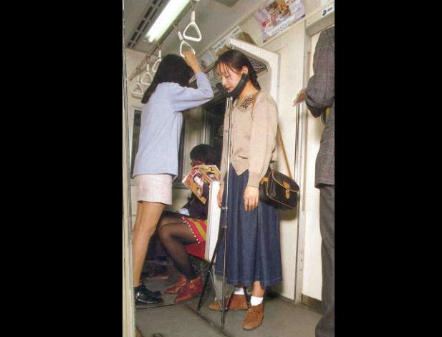

Slide 5
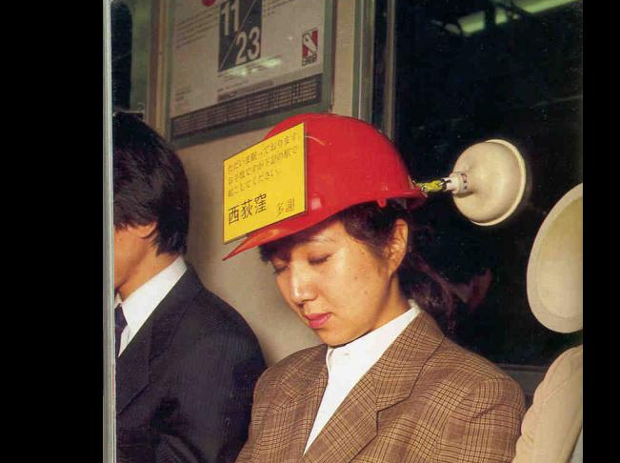

Slide 6
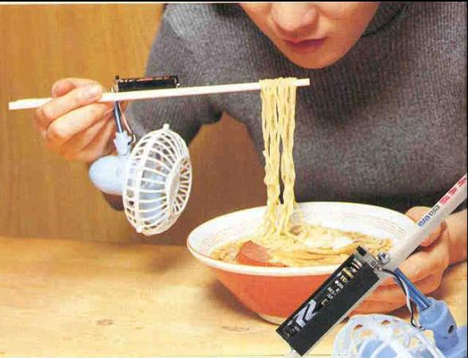

Slide 7
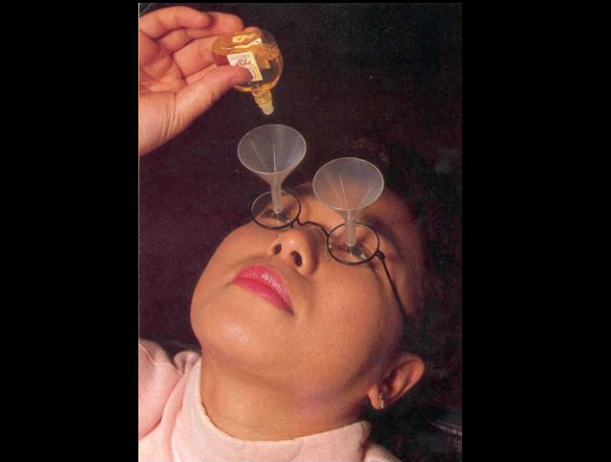

Slide 8


Slide 9


